Slide 1
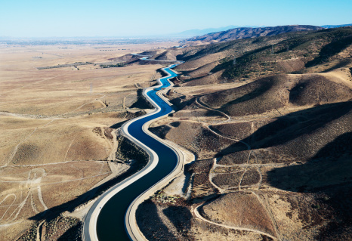
Water & Housing in Southern California
October 6, 2022
Ellen Hanak
PPIC Water Policy Center

Slide 2
So Cal region is home to half of all Californians. Inland areas are growing faster, but most still live near coast
From: Escriva-Bou et al. Water Partnerships Between Cities and Farms in So Cal and the SJ Valley (PPIC 2020)

Slide 3
Southern California has a diverse supply portfolio, with local and imported sources—including water purchases
Notes:
From 1976 to 2015, the area served by MWD imported an average of 2.2 million acre-feet (maf), nearly 60 percent of all water use (MWD 2016b) (Figure A6). The remainder is supplied from local sources, especially groundwater (more than 80%), but also local surface projects, a growing amount of recycled wastewater, and some desalination.

Slide 4
Since the early 1990s, region has invested massively in expanding water storage capacity
Notes:
To manage droughts, Southern California has invested heavily in water storage. MWD has developed over 6 maf of storage capacity since the 1980s, a 15-fold increase

Slide 5
Regional demand (and demand projections) have been falling over time thanks to declining per capita use

Slide 6
So Cal benefits from an interconnected water grid, but some areas are not as well tied in (yet)

Slide 7
Water use fell considerably during last drought, and savings persisted going into this one
From: Escriva-Bou et al. Are California’s Cities Conserving Enough Water? (PPIC blog, 2021)

Slide 8
This time, cities in most regions (incl. So Cal) have not achieved level of conservation Governor is requesting …
Notes:
While impacts were most concentrated in the north during 2021
The impacts in 2022 are going to be felt statewide
Elaborate in city:
While in 2021 we didn’t see many restrictions in urban water use, only in some agencies in the North Coast and the South Bay
This is likely to change in 2022, and we are going to see more urban impacts

Slide 9
…but So Cal communities really picked up the pace this summer in response to local agency policies
Notes:
While impacts were most concentrated in the north during 2021
The impacts in 2022 are going to be felt statewide
Elaborate in city:
While in 2021 we didn’t see many restrictions in urban water use, only in some agencies in the North Coast and the South Bay
This is likely to change in 2022, and we are going to see more urban impacts

Slide 10
Conservation, large stormwater projects, recycling most cost-effective sources of “new” water (along with trading)

Slide 11
What does this all mean for more housing?
Region has strong supply portfolio, and is on a good trajectory
Water portfolio diversification should continue to be a priority to build resilience to changing climate
There’s still potential for water savings in many communities as part of this strategy, along with supply diversification
New homes tend to use less water, reducing demand pressures
Connecting water and land use planning offers opportunities to push the envelope on water innovations

Slide 12
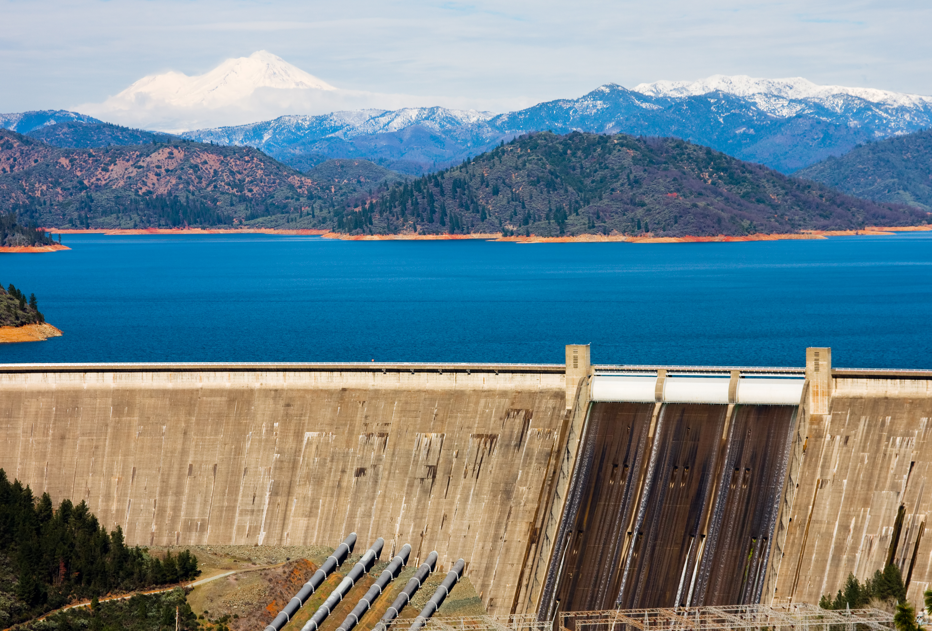
Thanks!
Notes:
Pixel-y image

Slide 13
About these slides
These slides were created to accompany a presentation. They do not include full documentation of sources, data samples, methods, and interpretations. To avoid misinterpretations, please contact:
Ellen Hanak (hanak@ppic.org)
Thank you for your interest in this work.

